Slide 1
Webinar: Recruitment Faux Pas
Their impact and how to avoid them.
Amber Dique-Bellete
Global Shortlisting & Selection Leader
Employment Office
amber.dique-bellette@employmentoffice.com.au
07 3330 2555

Slide 2
Thank you for joining us for today’s Webinar
Housekeeping:
This is a Webinar, which means that your speakers are on mute at the moment and we won’t be able to hear you, however we would love your participation! So If you have any questions please type them in the GoToWebinar Action Pane on the right side of your screen, and we will leave time at the end to go through them.
Our Webinar will last 30-45mins
If you experience any technical difficulties at all, either let us know via the Action Pane or call us directly on 07 3330 2555 (ask for Tahnee) and we’ll happily help!

Slide 3
What we’ll cover today
Why it’s important to understand what can go wrong, and how small things may be affecting your ability to attract and retain top talent
Each part of the recruitment process and what the most common recruitment faux pas are of each
How to avoid some of the easy mistakes to make and robust out your process
Questions

Slide 4
Why?

Slide 5
The Process
Defining the role
Selecting decision makers
Attraction
Screening
Shortlisting
Interviewing
Reference checks and other testing
Selection and Offer
Candidate care
Wrap up and feedback

Slide 6
Poll?

Slide 7
Defining the Role & Determining who is Involved
LinkedIn’s head of recruiting, Brendan Browne says one of the most common recurring mistakes hiring managers make is setting unrealistic expectations.
Make it creative and inclusive
Dry and generic job descriptions could very well chase away great candidates
Clearly define the specific qualities and qualifications
Describe the culture and goals of the company and how the ideal candidate would fit in to that
If you were describing a position to a friend, would it be different to how you write a job description?
The Purple Unicorn

Slide 8
ATTRACTION:
Finding your candidates

Slide 9
Attraction – Finding your candidates
Saying what everyone else says
Not targeting your desired candidates
Only recruiting through active strategies
Only advertising on one job board
Not being specific enough
Making the application process too hard
Skipping the ‘what’s in it for them’
73% of the candidate market are passive job seekers
Not understanding how you are perceived in the candidate market…or what people are saying about you

Slide 10
Screening and Shortlisting
Unconscious BIAS
Waiting for the perfect ‘on paper’ candidate
Making assumptions
Taking too long
Time is everything…
Research indicates the top 10 percent of candidates are often gone from the marketplace within 10 days.

Slide 11
INTERVIEWING

Slide 12
Interviewing
Length of Interview
Information Sharing
Interview Questions
The Candidate Experience
Style of Interview
166 interviewers were asked before interviewing 691 students at a career fair. One of the queries was how long did it take to come to a conclusion?
Transparency
Video Interviews
How many rounds of interviews?

Slide 13
References, testing and other checks
Reference Checks
Skills Testing
Behavioural Testing
Criminal History Checks
Financial Background Checks

Slide 14
Selection and Offer
Don’t assume a verbal acceptance is official
Make an appropriate offer
Confirm housekeeping items
Timing is important

Slide 15
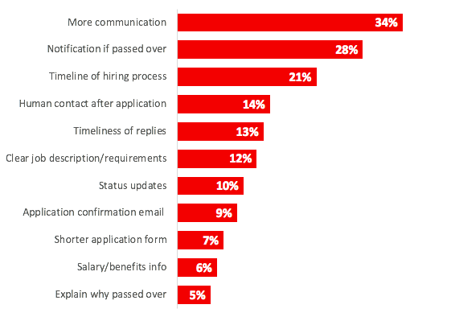
Candidate Care and Wrap Up

Slide 16
Candidate Care and Wrap Up
Feedback – What were the results, what worked, and what didn’t?

Slide 17
Questions?

